Slide 1

Vigenère cipher and modern approach to cryptanalysis
Swapnil Paliwal (sp3911)
Arun ram mohan (amr2356)

Slide 2
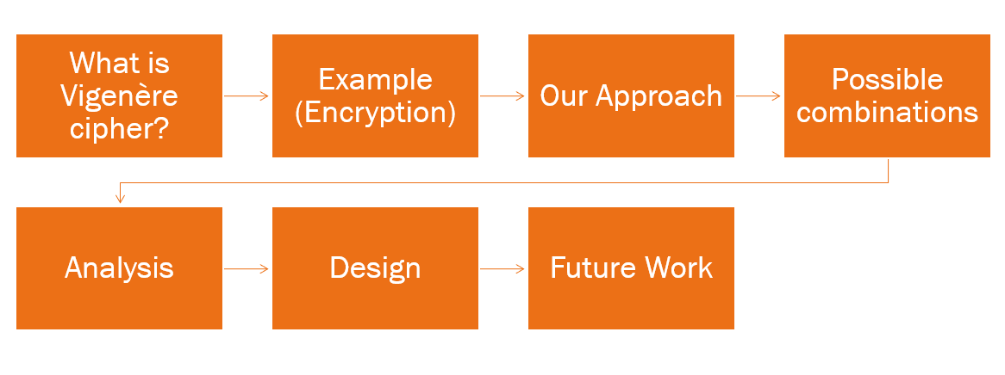
Index

Slide 3
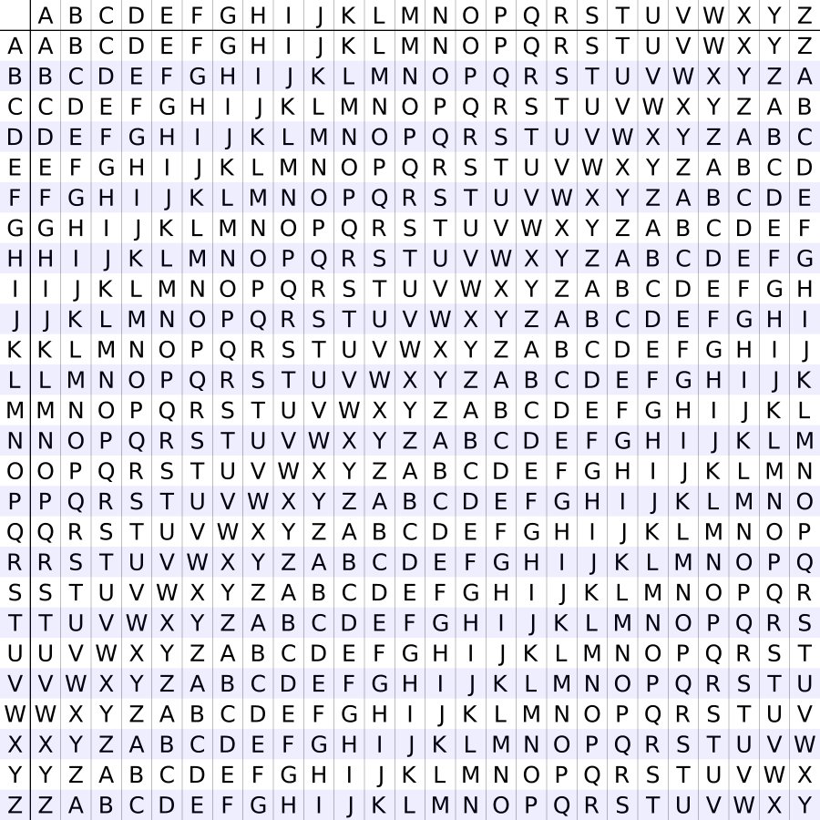
Vigenère cipher
Invented by Blaise de Vigenère.
It was considered secure for 300 years.
Encryption Message: M A N L Y Key: A B C A B Cipher: M B P L Z
Encryption:
Decryption:

Slide 4

Example (Encryption) - Video

Slide 5
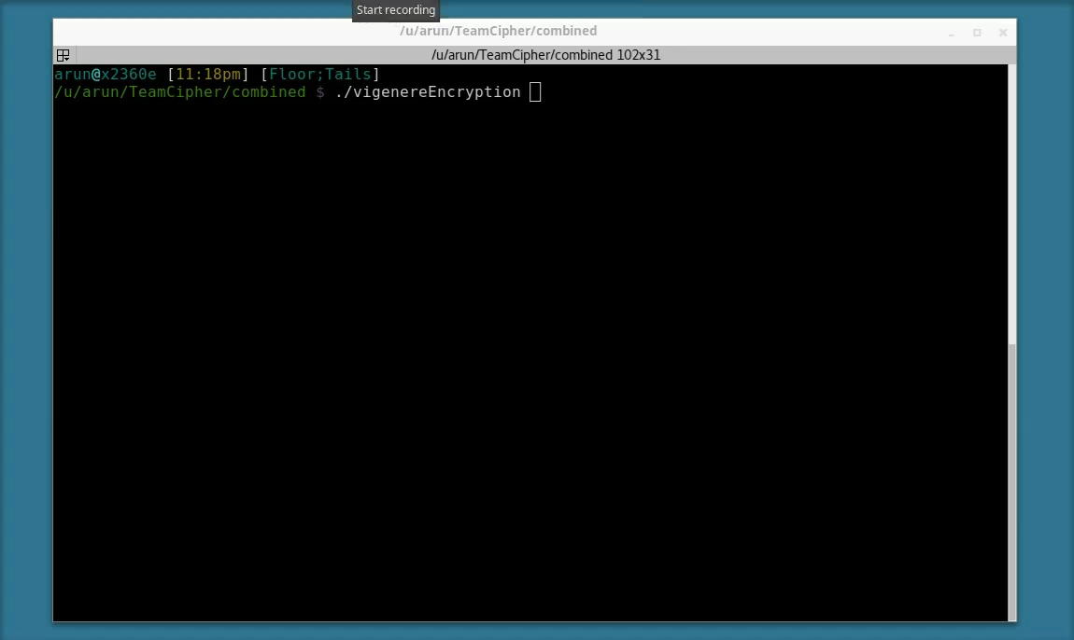

Slide 6
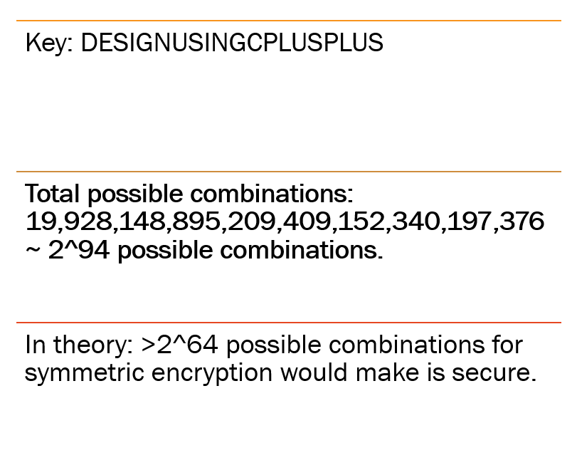
Example
If possible combinations are greater than 340,282,366,920,938,463,463,374,607,431,768,211,456. It is infeasible for all the computers combined, to break the cipher.

Slide 7
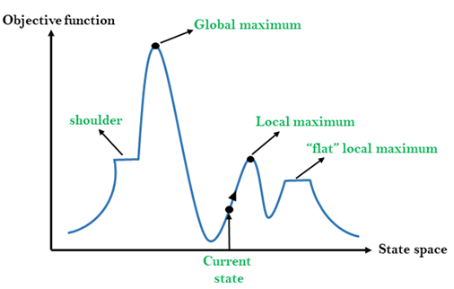
Our approach
Hill climbing approach requirements: A scoring function.
Our scoring function: Quadgram sequence scores. What is Quadgram sequence? 4-character sequence of the message. Example: SWAPNILARUN -> SWAP WAPN APNI PNIL NILA ILAR LARU ARUN

Slide 8
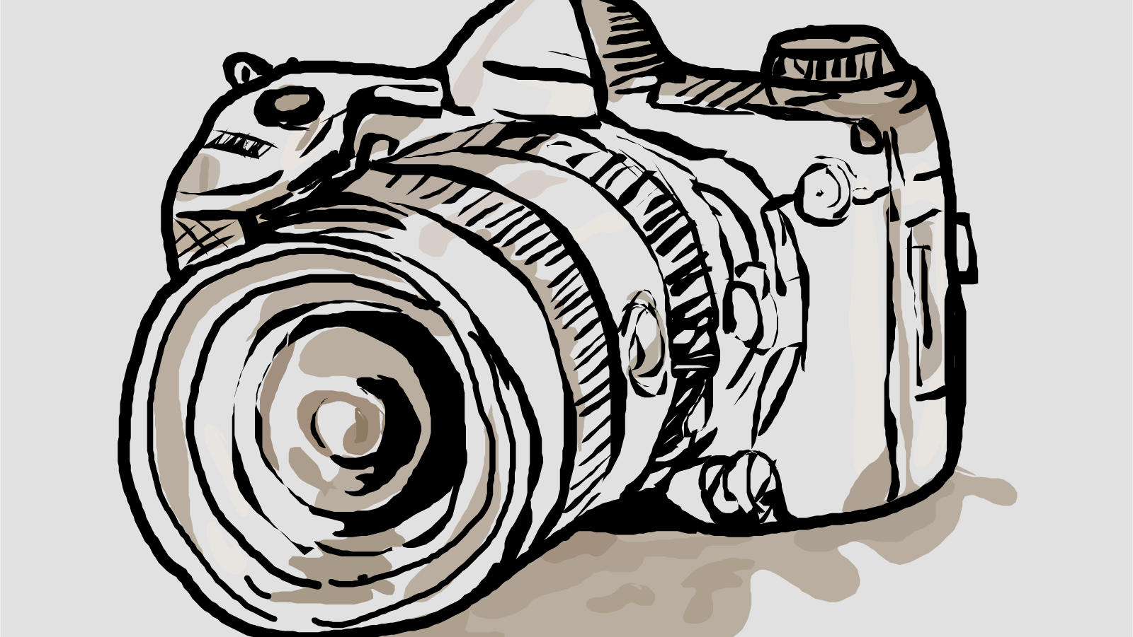
Example (Cryptanalysis) - Video

Slide 9
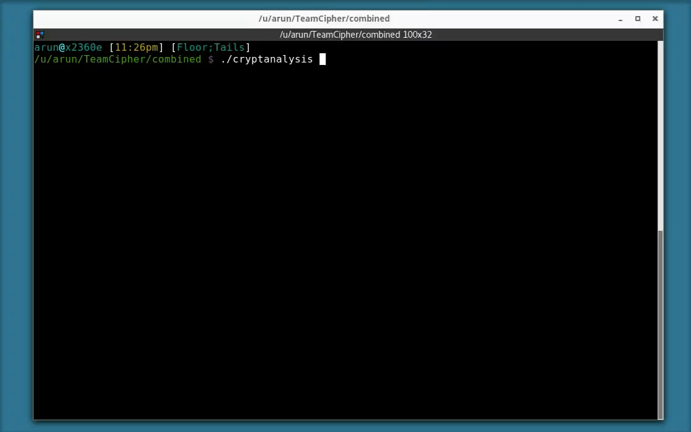

Slide 10

Analysis

Slide 11
Insights
Length of ciphertext | Length of key | Cipher/key | Average time (s) | Average brute force time (years) | Combinations
2005 | 60 | 33.42 | 281 | 1.25e+69 | 7.9e+84
2005 | 55 | 36.45 | 231 | 1.06e+62 | 6.66e+77
1467 | 37 | 39.65 | 128 | 3.58e+36 | 2.26e+52
1467 | 32 | 45.84 | 88 | 3.01e+29 | 1.90e+45
1467 | 26 | 56.4 | 47 | 9.76e+20 | 6.16e+36
566 | 26 | 21.77 | 13 | 9.76e+20 | 6.16e+36
917 | 35 | 26.2 | 66 | 5.30e+33 | 3.34e+49
389 | 12 | 32.4 | 14.6 | 15.13 | 9.54e+16
99 | 3 | 33 | 0.01 | 2.783e-12 | 1.76e+4
240 | 14 | 17.14 | - | 1.03e+4 | 6.45e+19
20 text combinations for each ciphertext length
For brute force we assume that computer tests 200 million keys/s; assuming each key check consumes 10 cycles on a 2.4 GHz processor
Life of universe is 1.38e+10 years

Slide 12
Insights
Cipher/key

Slide 13
Insights
Length of ciphertext | Length of key | Cipher/key | Average time (s)
2005 | 15 | 133.67 | 19
1800 | 15 | 120 | 18
1600 | 15 | 106.67 | 17
1400 | 15 | 93.33 | 23
800 | 15 | 53.33 | 26
600 | 15 | 40 | 130
20 text combinations for each ciphertext length
Total key combinations are 1,677,259,342,285,725,925,376
Brute force time: 129,019,949,406* Age of universe

Slide 14
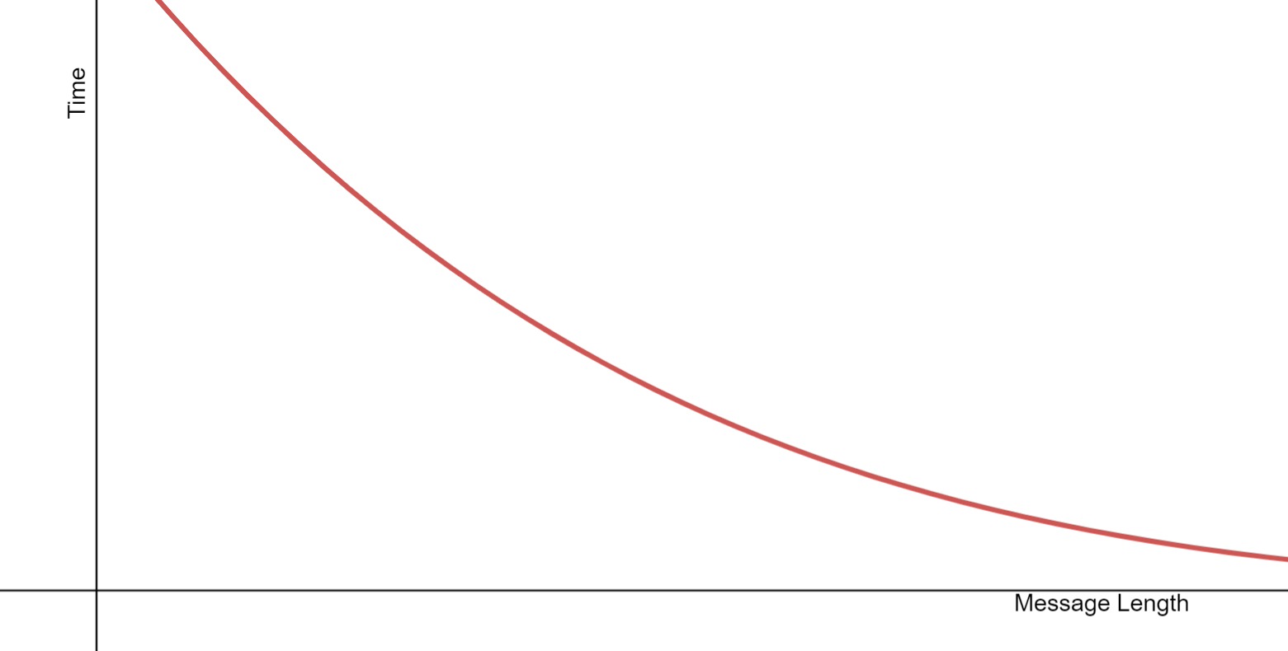
Insights
Guessing the right key is not possible when the message length drops very low

Slide 15
Insights

Slide 16

Design

Slide 17
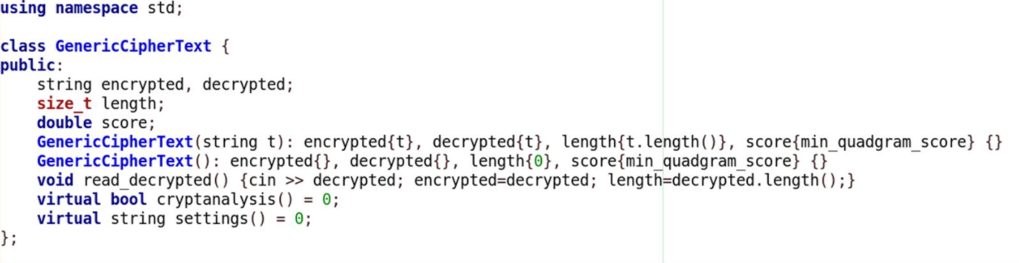
Creating a class hierarchy

Slide 18
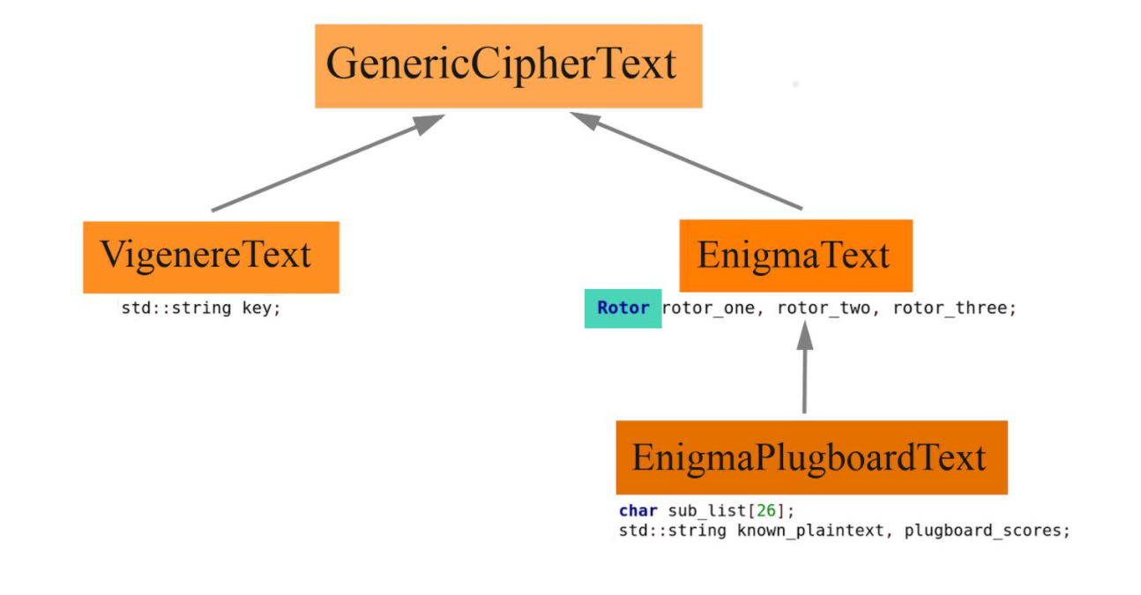
Creating a class hierarchy

Slide 19
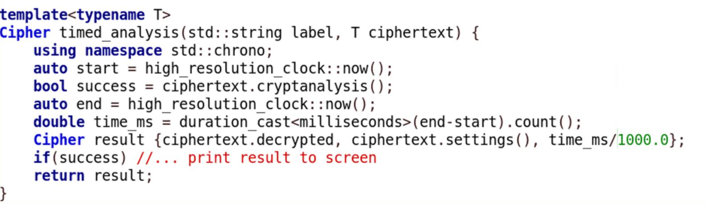
Executing and timing using a template

Slide 20
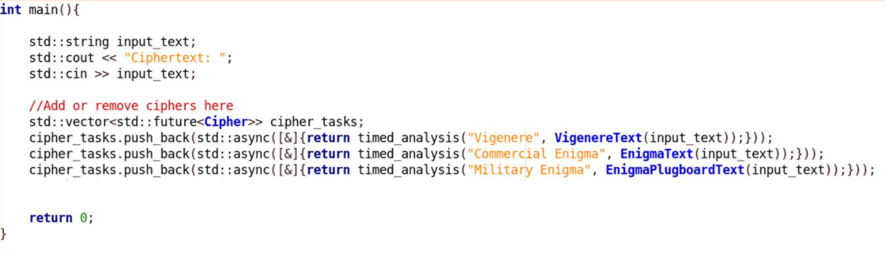
Using concurrency

Slide 21
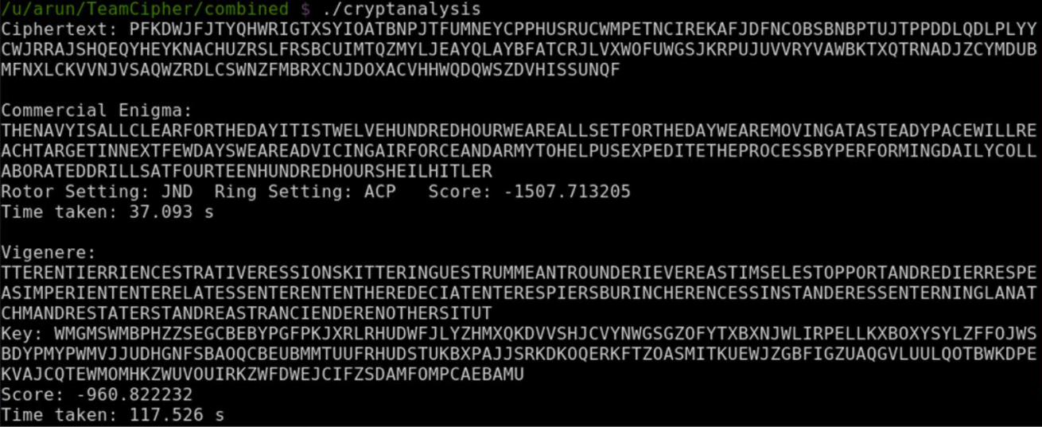
Sample output #1

Slide 22
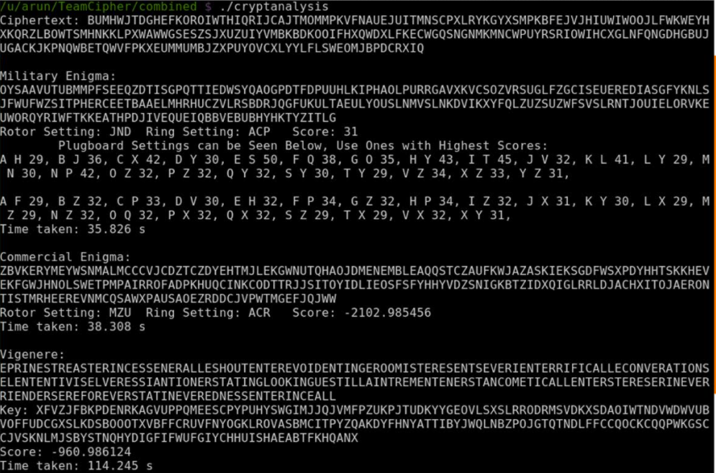
Sample output #2

Slide 23
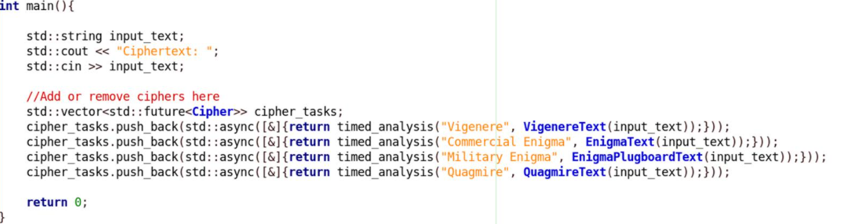
Adding more cipher implementations

Slide 24
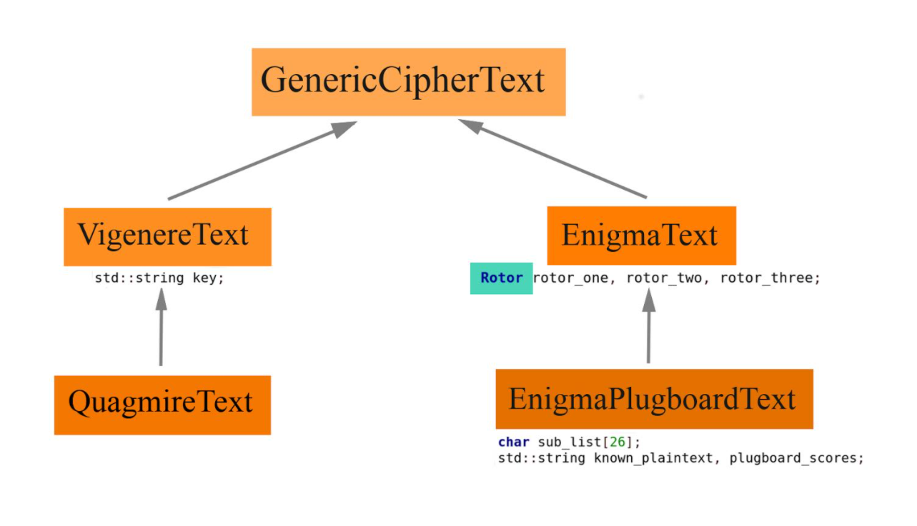
Updated hierarchy

Slide 25
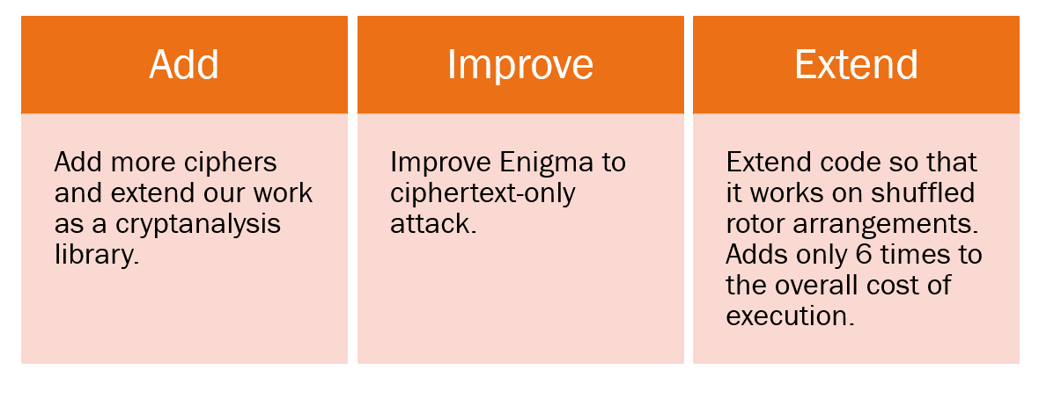
Future work

Slide 26

Thank you
Swapnil Paliwal (sp3911)
Arun Ram Mohan (amr2356)

